Slide 1
Prediction based on date selected
File created by: Ratodyasinh Parmar
700#: 700726113
CIS 5690: Advance System Project (30240)
Dr. Sam Ramanujan
University of Central Missouri

Slide 2
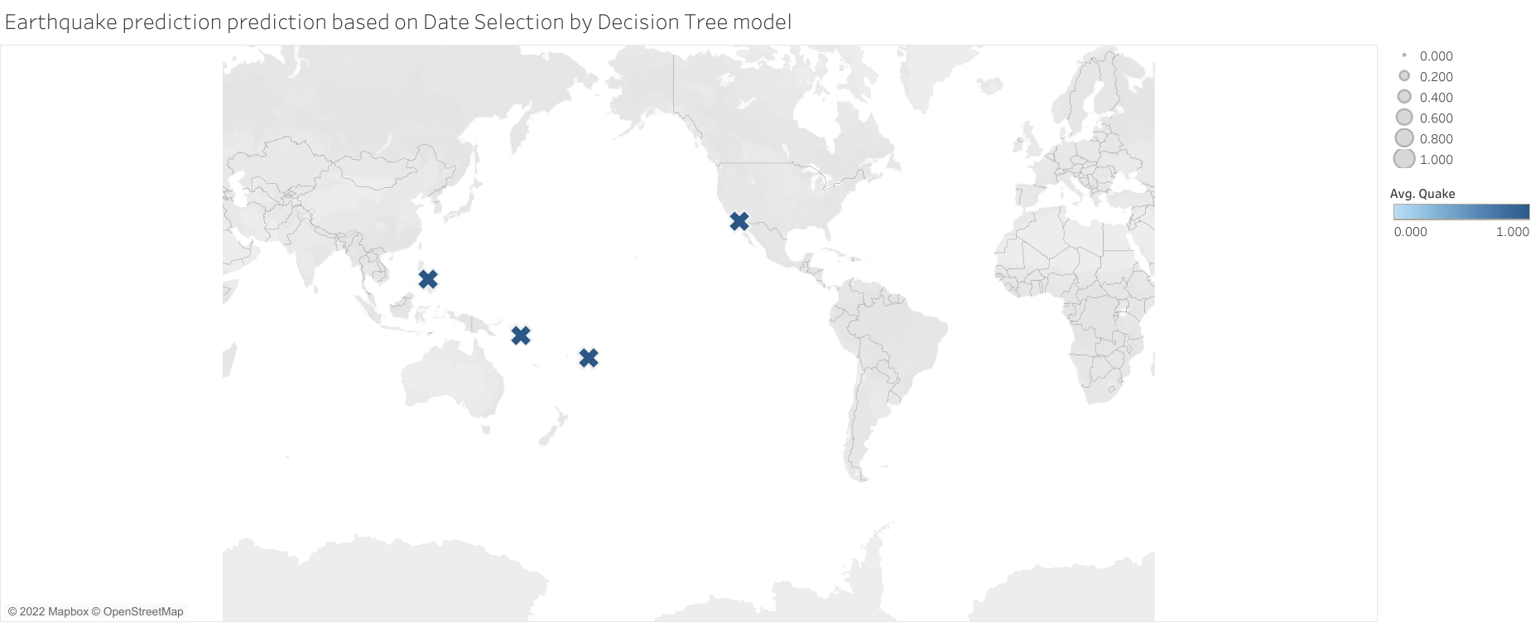

Slide 3
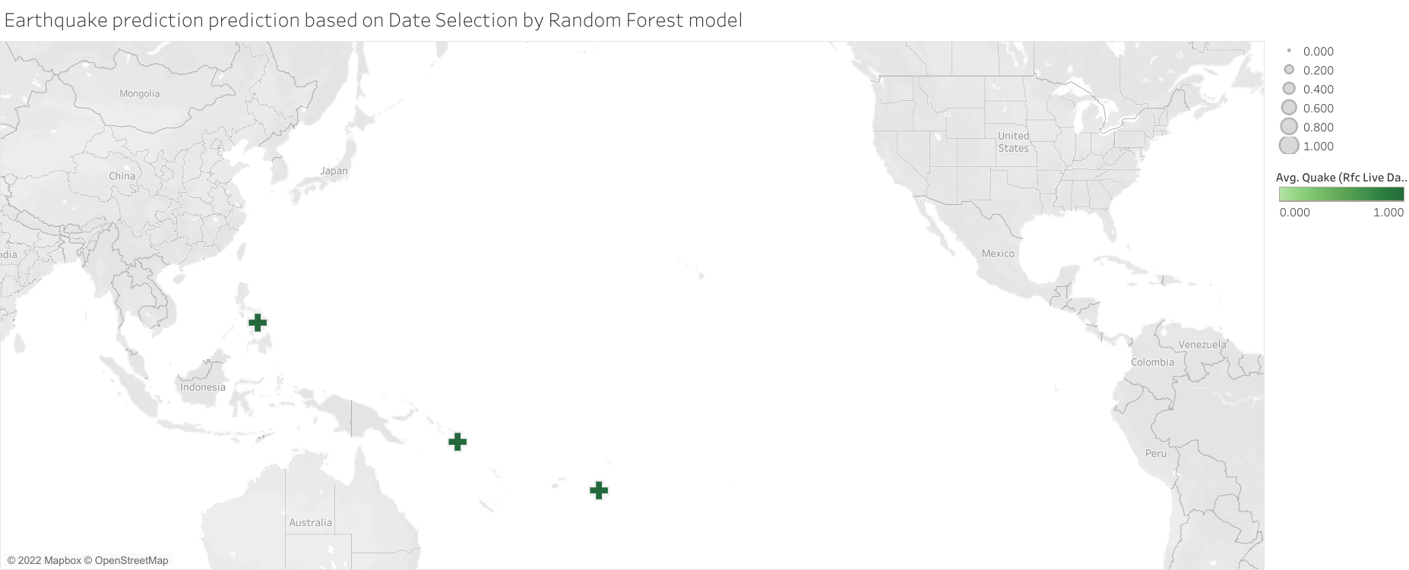

Slide 4
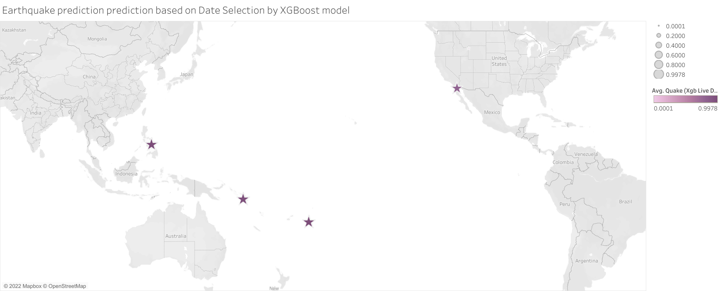

Slide 5
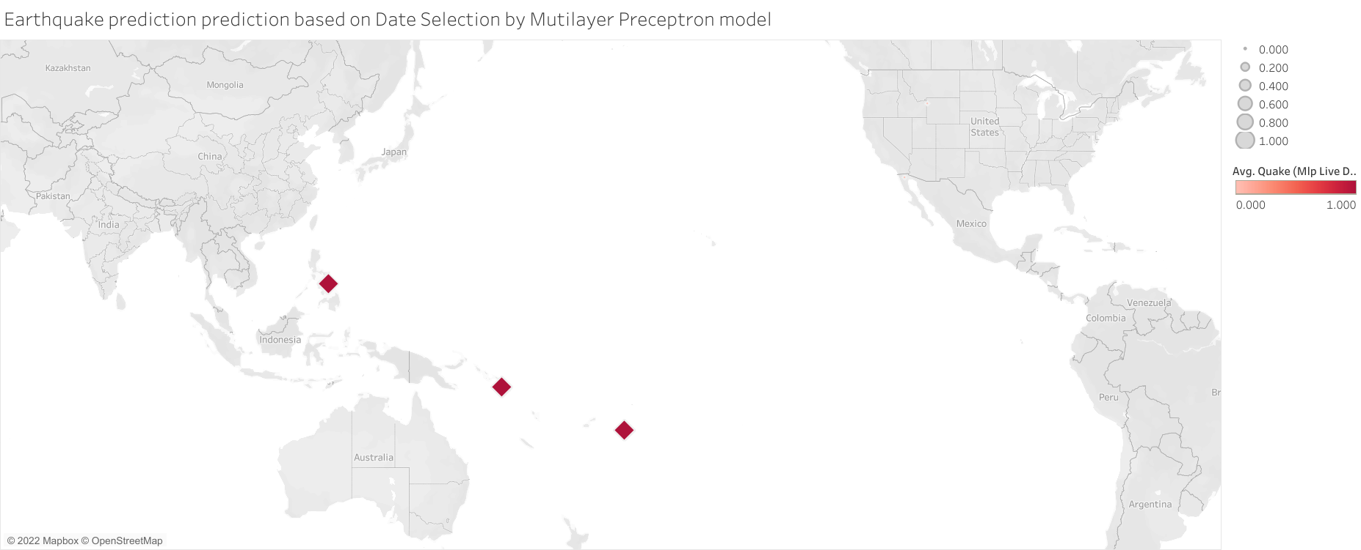

Slide 6
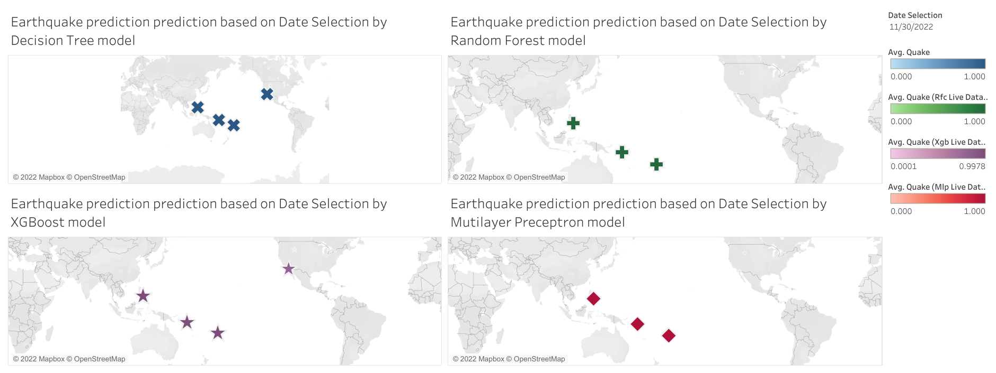

Slide 7
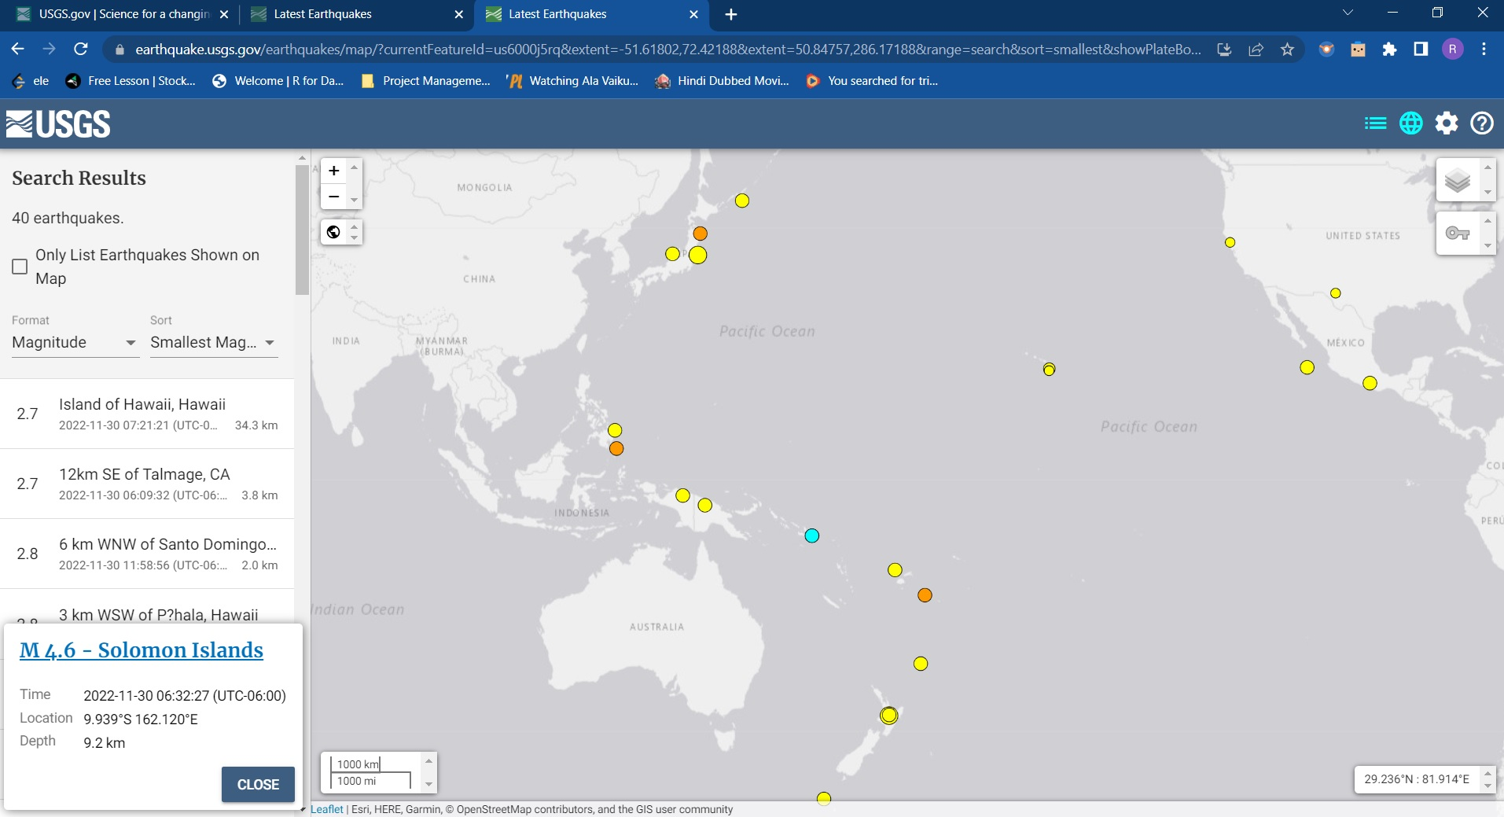
Verification from websites

Slide 8
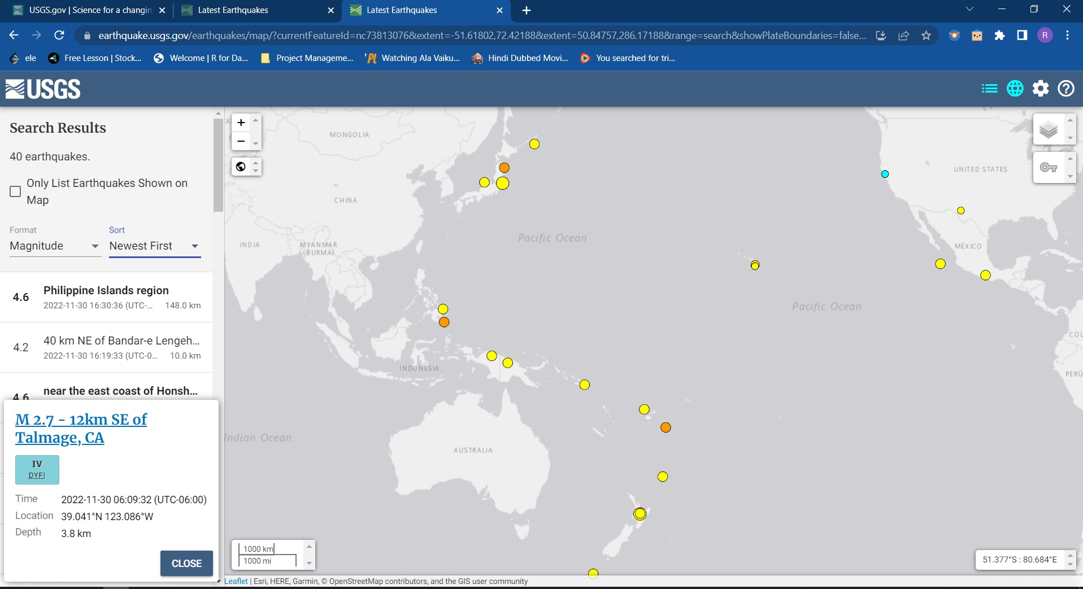

Slide 9
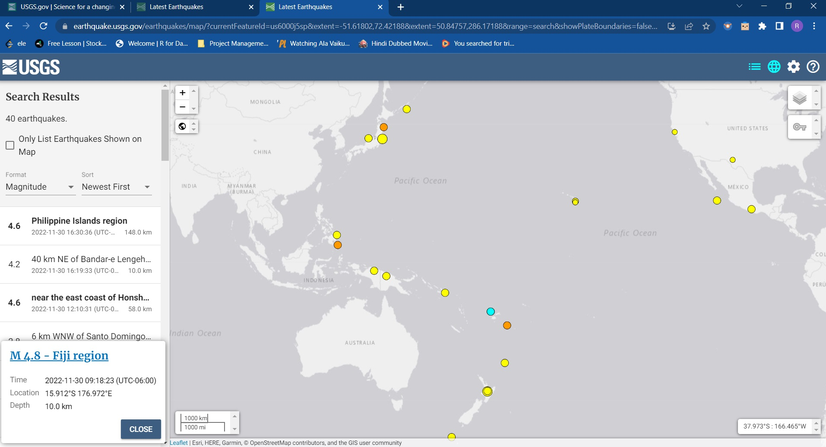

Slide 10
